Slide 1



Safeguarding Canada’s Airports
The Importance of Compatibility
Natalia Lee Ho & Joshua Horst
April 30, 2025
Source: OregonLive

Slide 2
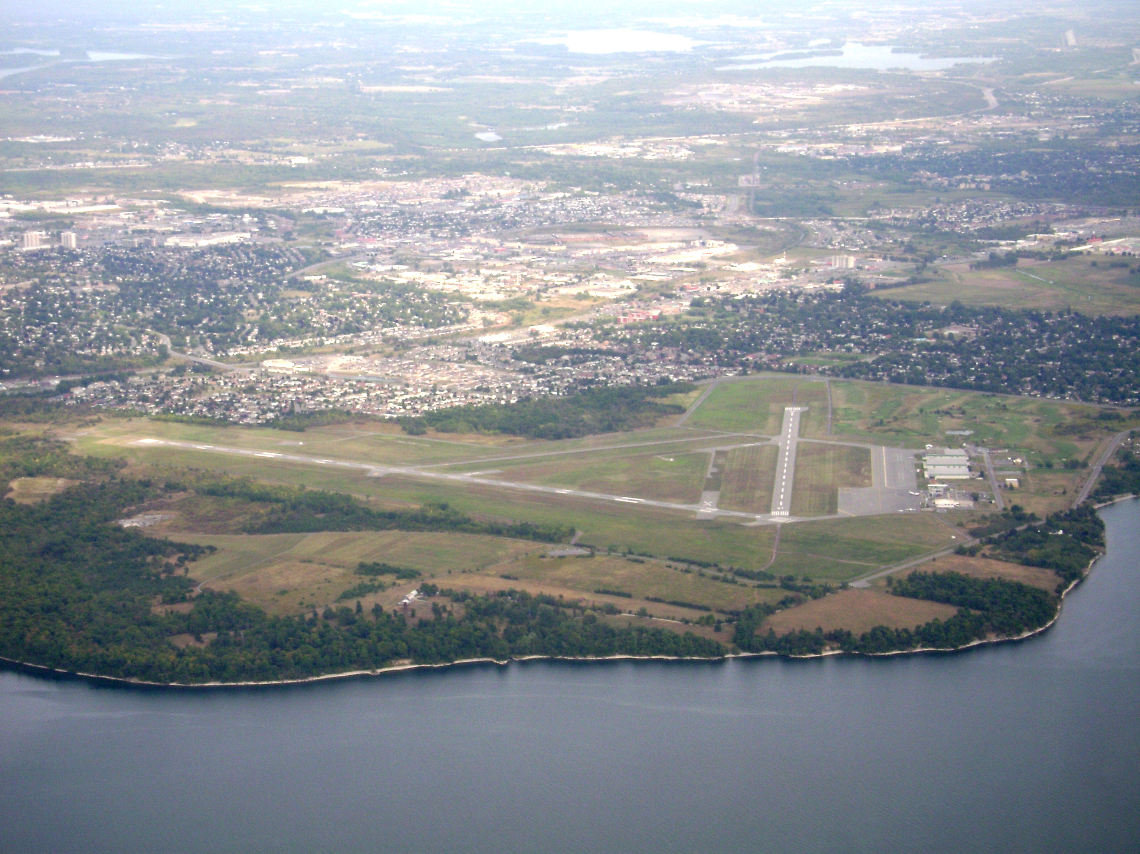
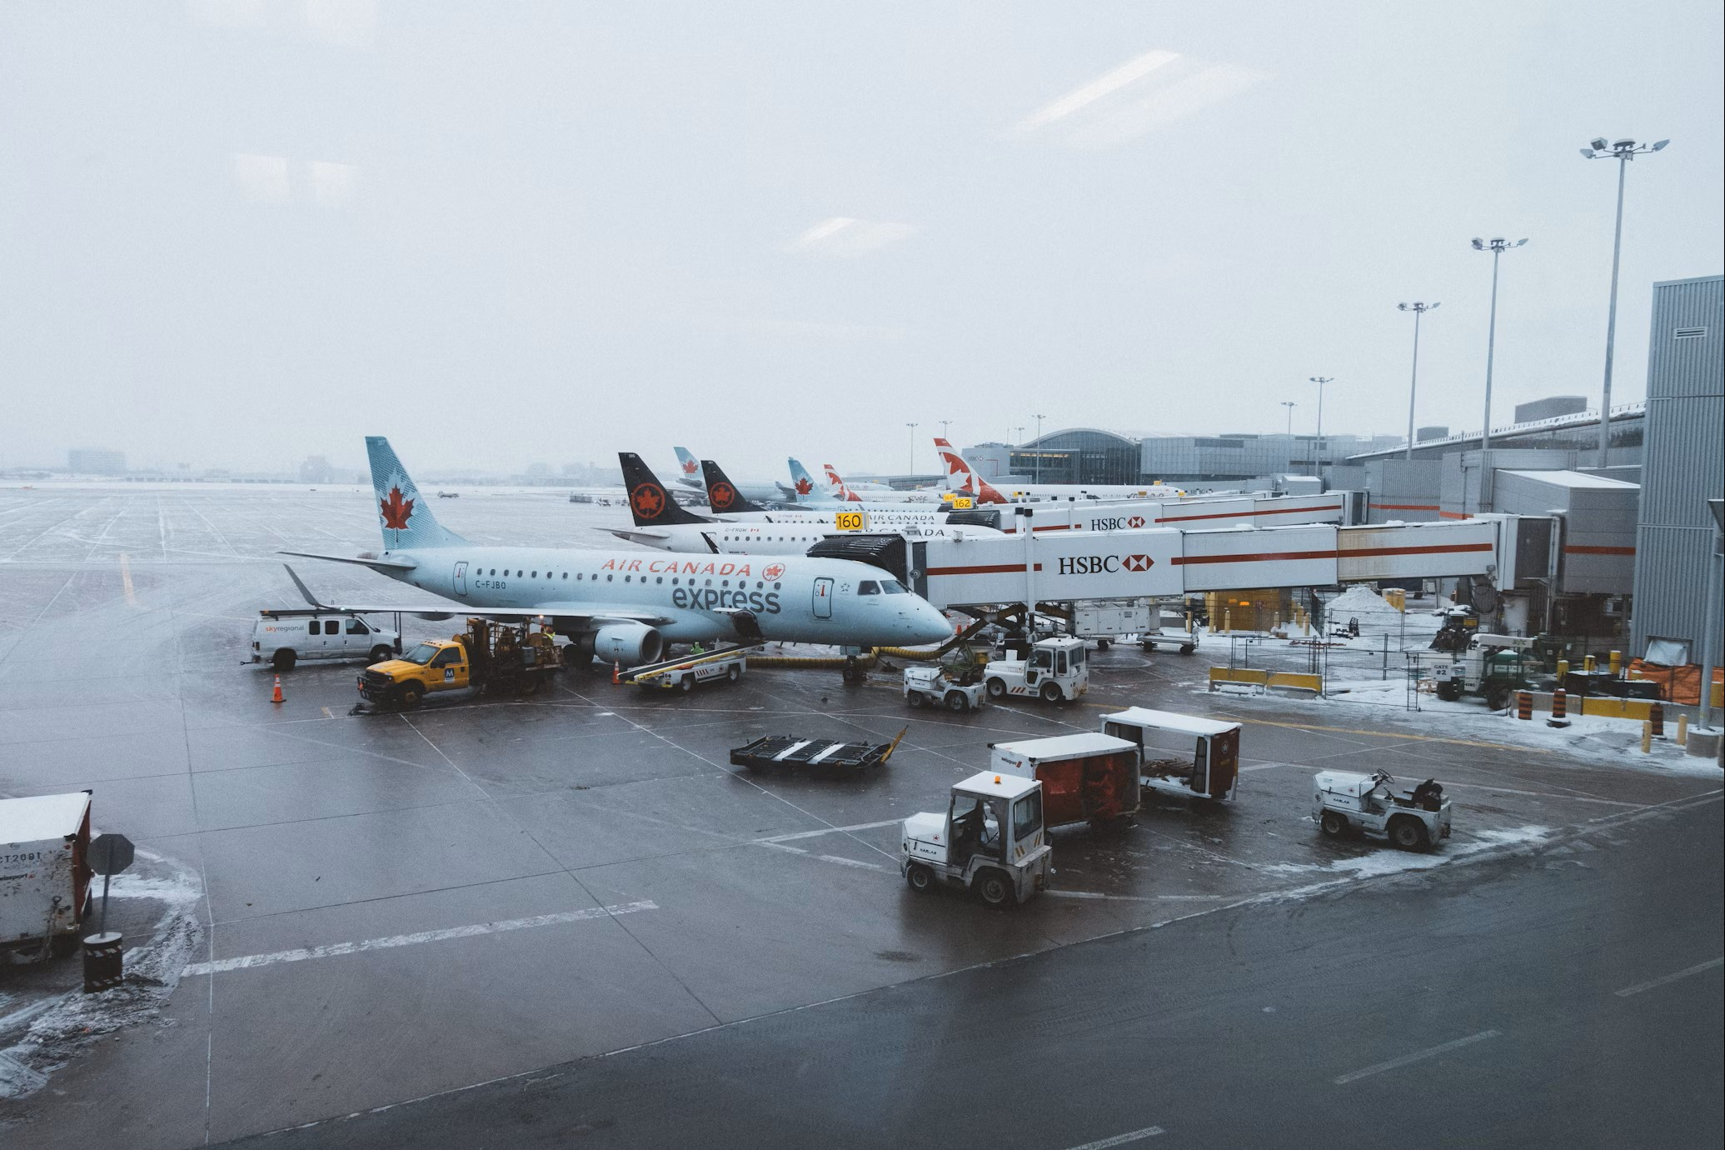
Airports: Why are they so important?
Airports, big and small, each have important roles.
Above all, airports are essential for the movement of people and goods:
  Trade and travel
  Domestic and international
Source: MapCarta
Source: David Preston (Unsplash)

Slide 3
A Note on Jurisdiction in Aeronautics
Complex legal framework
Functional in scope, instead of geographic
  It’s the “use” that matters
Aeronautics is federal jurisdiction
  But provincial and municipal may impact airport activities
    Provincial: planning acts
    Municipal: land use plans
  Tools at all government levels can be used for safeguarding.

Slide 4
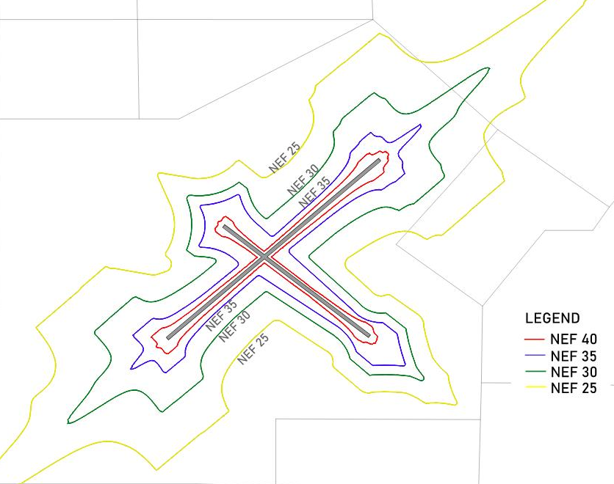
Safeguarding: What is it?
Safeguarding: the protection of airspace around an airport to prevent the development of airport-incompatible land uses
  Height restrictions
  Land use restrictions (radio interference, wildlife hazards)
Airports and their surrounding communities can impact each other.
  E.g., Aircraft noise

Slide 5
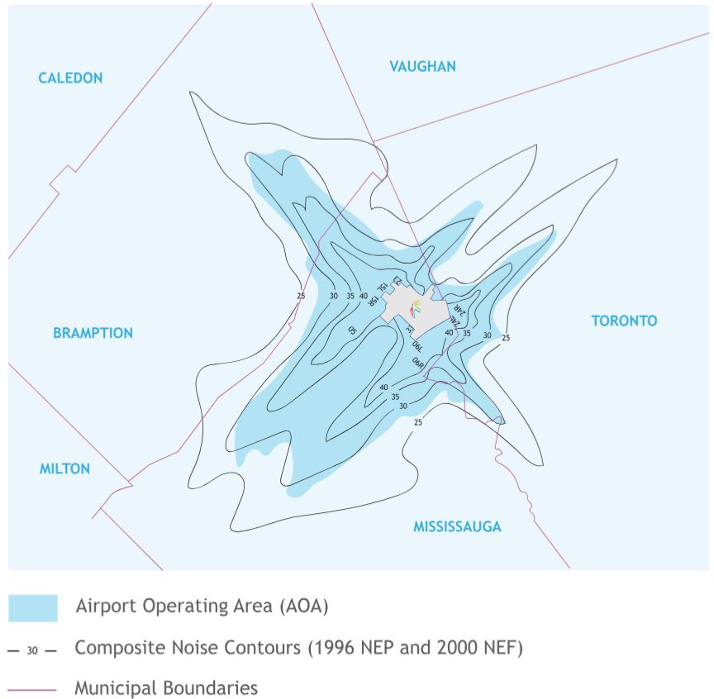
Case Study:
Toronto Pearson International Airport
YYZ Airport Land Use Program:
  Airport Zoning Regulations (AZR)
  Airport Operating Area (AOA)
AZR established under federal aeronautics act (height restrictions, etc.)
AOA based on noise contours (NEF): no sensitive land uses within AOA, with some exceptions
Source: GTAA

Slide 6
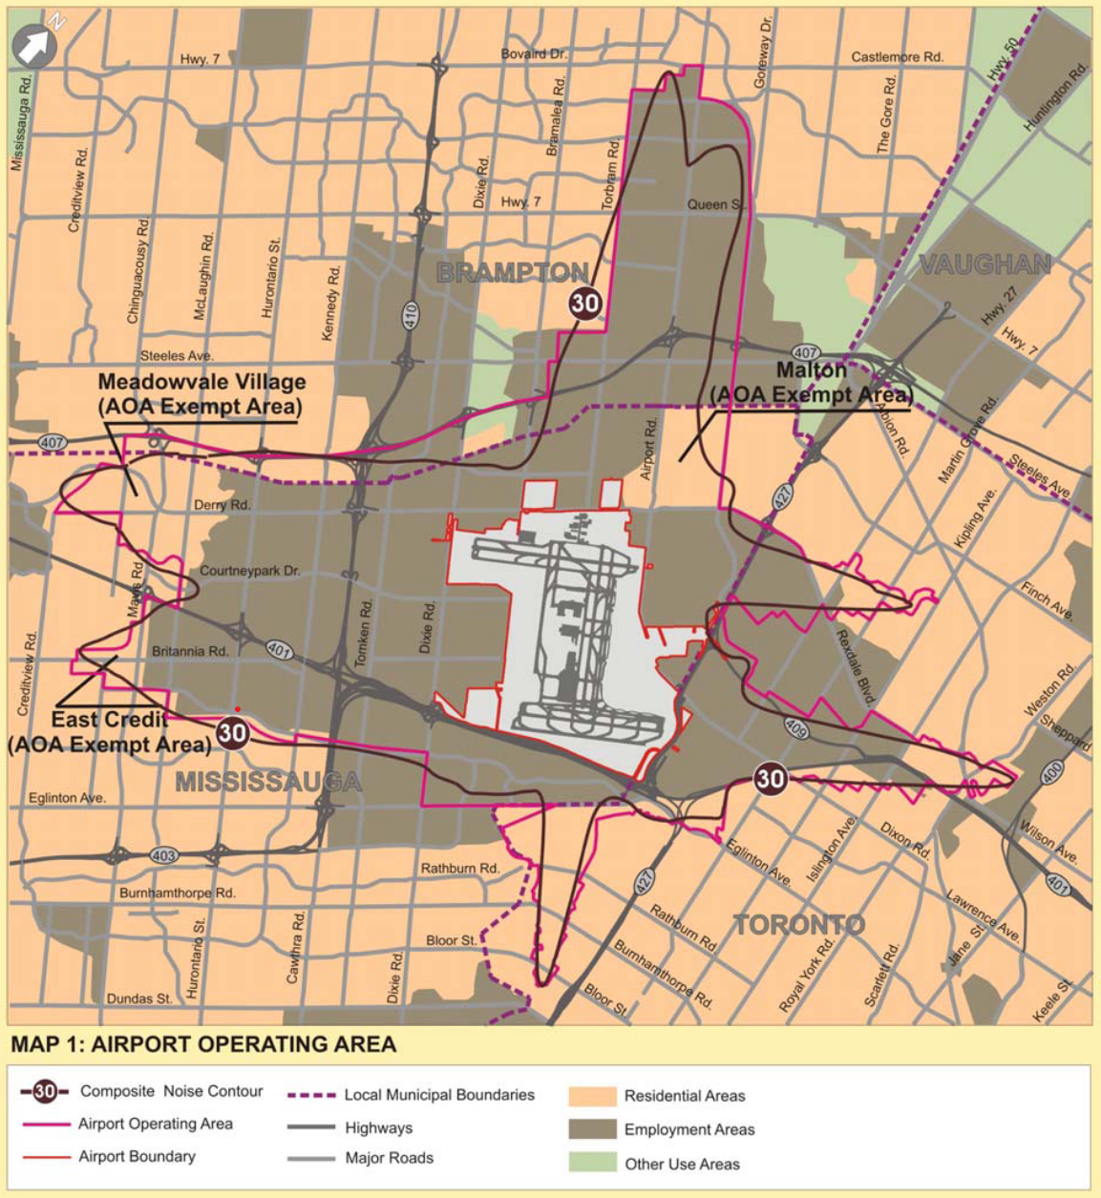
Case Study:
Toronto Pearson International Airport
In 2023, MMAH issued a MZO to permit mixed-use commercial/ residential of up to 50 storeys for two properties in Mississauga.
5645 Hurontario St. was in conflict with:
  AZR (height restriction);
  AOA (within 30 NEF contour);
  Mississauga OP (supporting AOA)
Removed but important to stay vigilant
5645 Hurontario St.
Source: GTAA

Slide 7
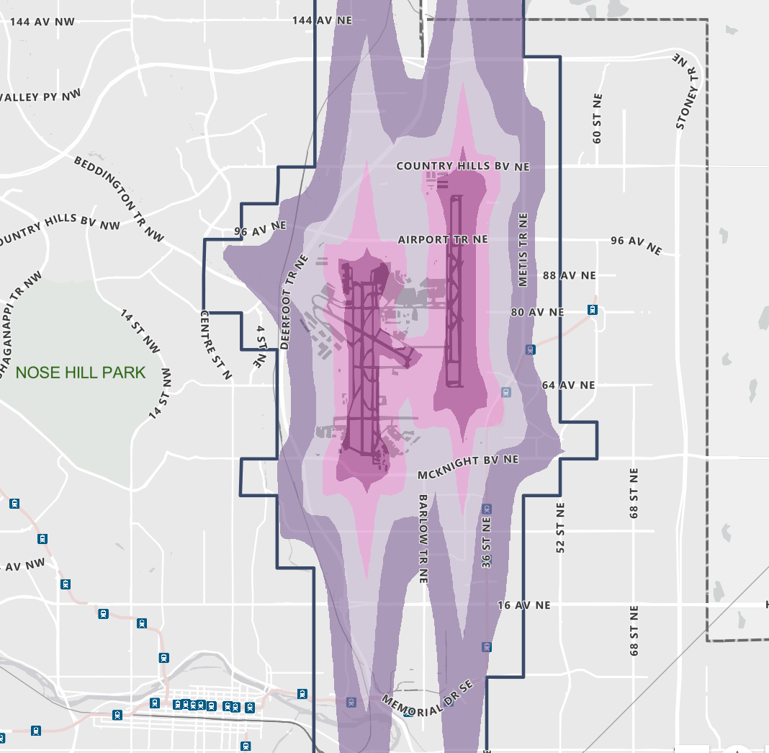
Case Study:
Calgary International Airport
Calgary Airport Vicinity Protection Area (AVPA): restricts sensitive land uses within certain NEF areas
AVPA amended in 2021 via MO after collaboration:
  Certain intensification for select communities in 30-35 NEF (2019)
  Places of Worship and Auditoriums permitted in 45 NEF (2021)
VISTA HEIGHTS
INGLEWOOD
Source: City of Calgary

Slide 8
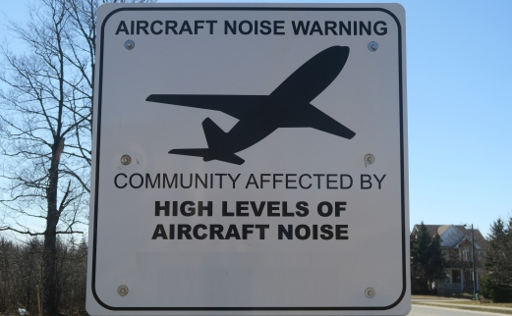
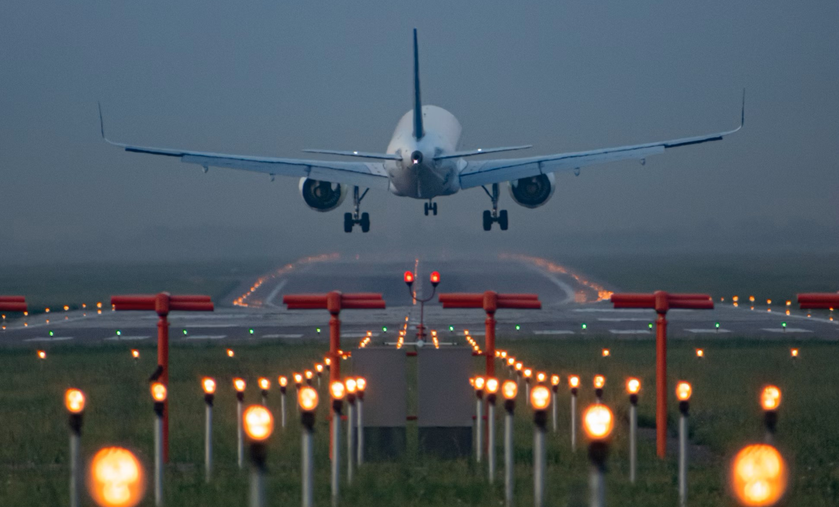
Technology and Safeguarding
Advancements in:
  Air traffic management
    Navigation and approach for landing
  Aircraft design
    Quieter engines
    Increased aerodynamics
Vulnerability and gaps in safeguarding
Important to maintain safeguarding but potential future opportunities (e.g., Calgary case study)
Source: Sonitus Systems
Source: Ilyas Dautov (Unsplash)

Slide 9

Where do we go from here?
Close collaboration between planners
  Aviation/airport planners,
  Land use/development planners,
  Transportation planners, etc.
Balancing of needs in public interest
Safeguarding tools and collaboration
Source: MIT

Slide 10
Thank you!
Source: OregonLive

