Slide 1
Ryan Ness
Sarah Miller
March 2025

Slide 2


The challenge
Flooding and wildfire are
the greatest climate threats
to housing in Canada
Housing construction continues in flood and wildfire hazard zones
Accelerating housing supply stands to worsen the problem
The costs will undermine affordability for all Canadians

Slide 3
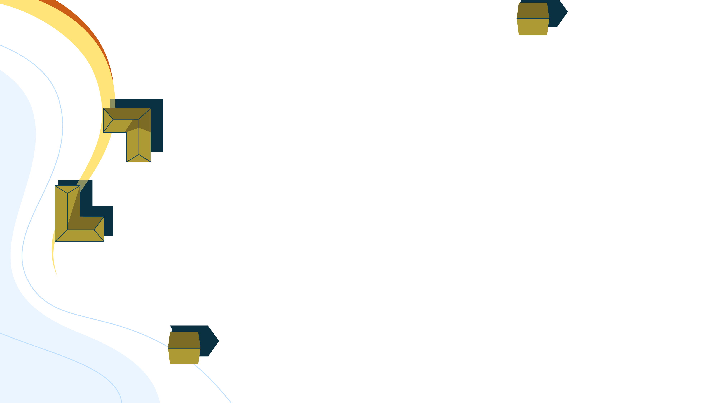
The most affordable home is the one you don't have to keep rebuilding
EMBARGOED

Slide 4


Summary
$
$
Under existing policies, new homes built in flood and wildfire zones could lead to billions in annual losses.
By directing a small percentage of new homes to safer areas, governments can prevent almost all of these losses.

Slide 5




Our approach
Projected where 5.8M new homes would be built by 2030 under existing policies
Evaluated existing land use planning, housing, and other policies that influence development decisions
Studied challenges to Indigenous communities in building climate-safe housing
Modelled flood and wildfire risks to 16M existing
+ 5.8M new homes
Explored promising policies from Canada and around the world to reduce risk

Slide 6
Modelling
Results

Slide 7
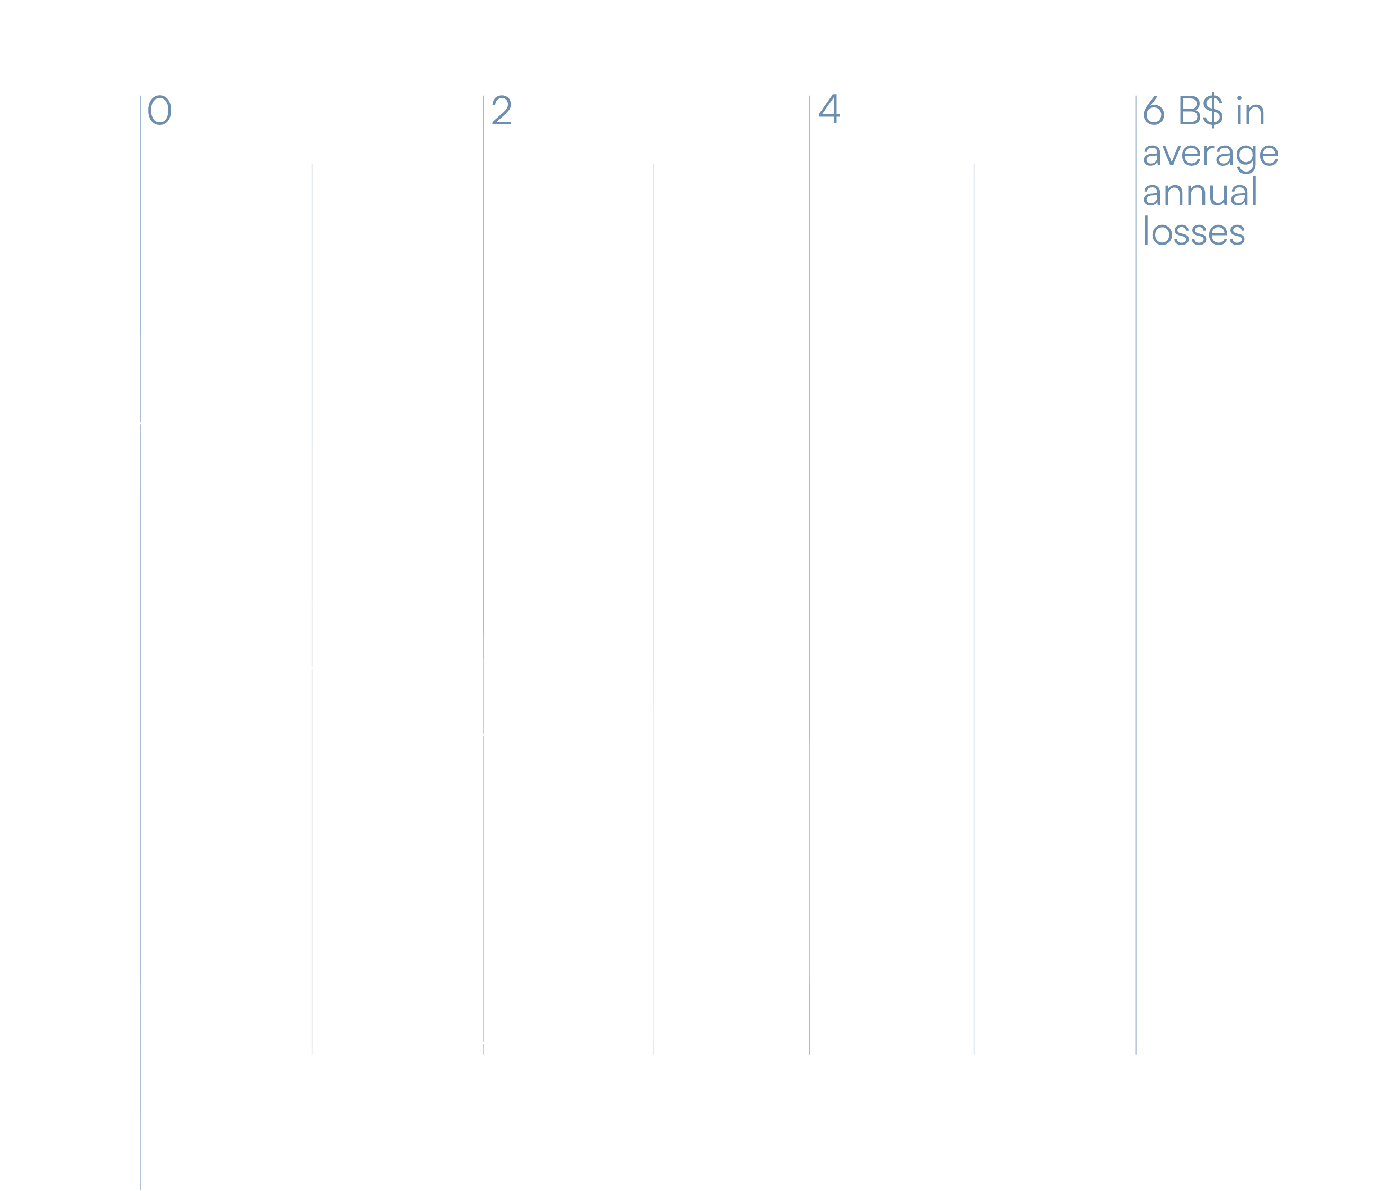
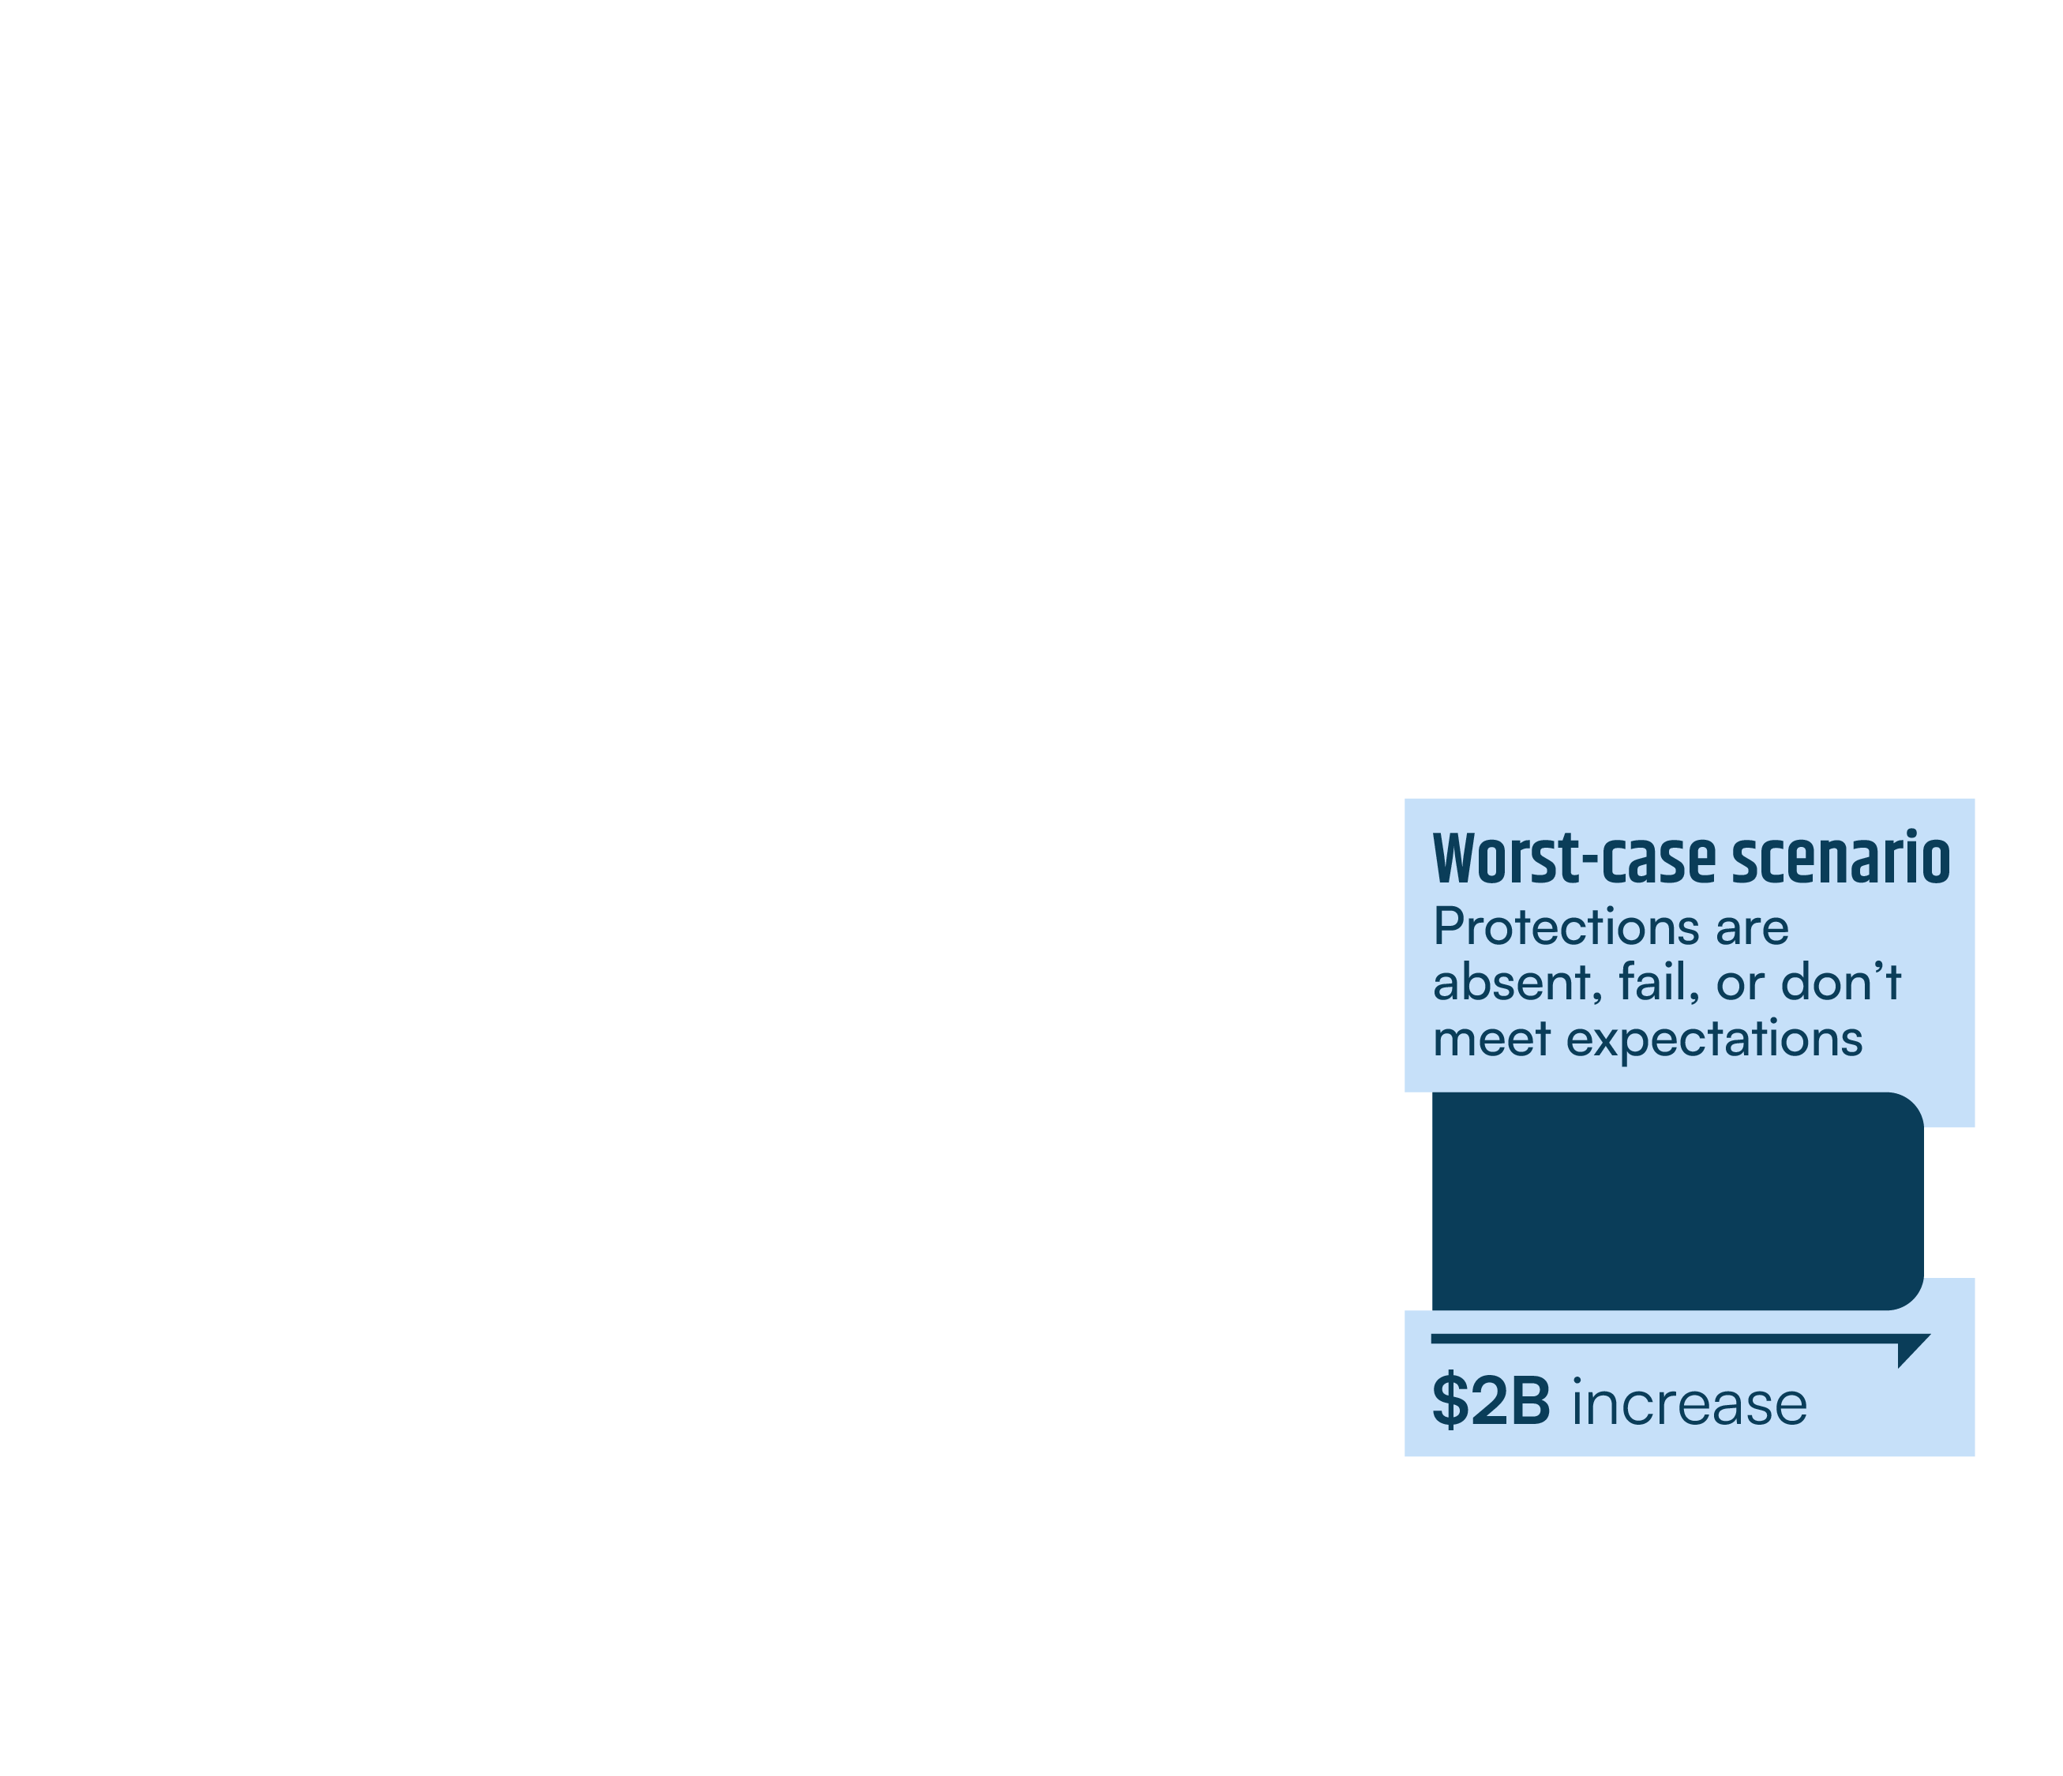
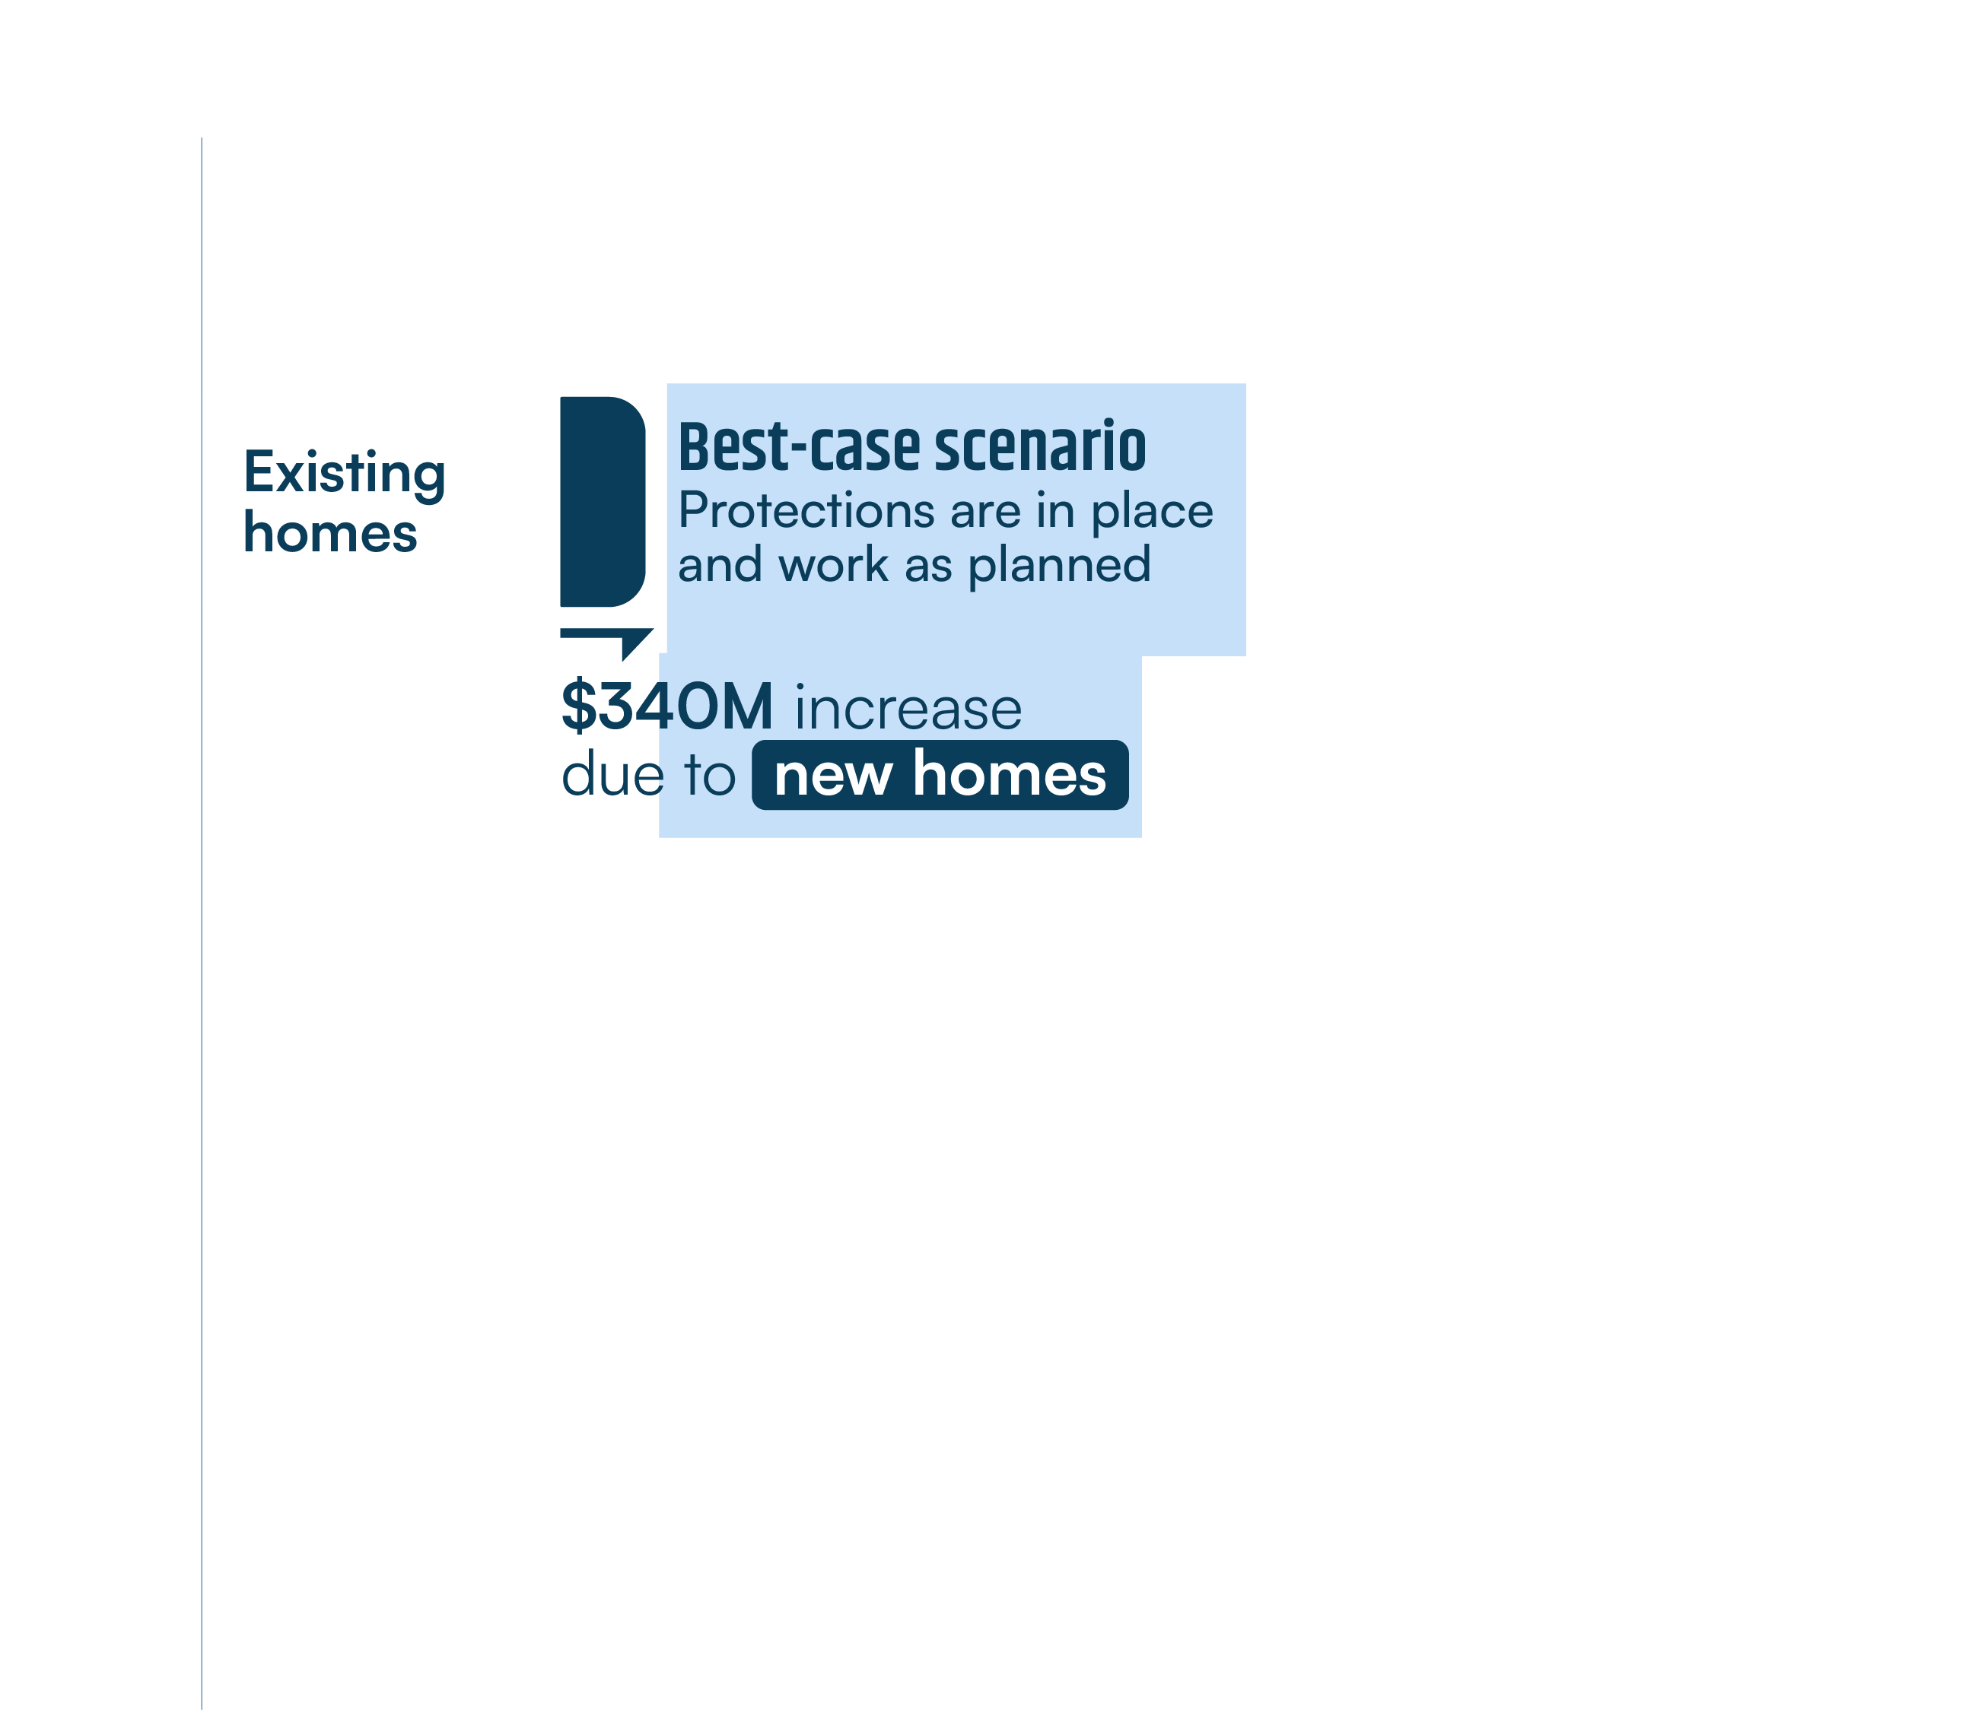
New housing under status quo policies adds major flood risk

Slide 8
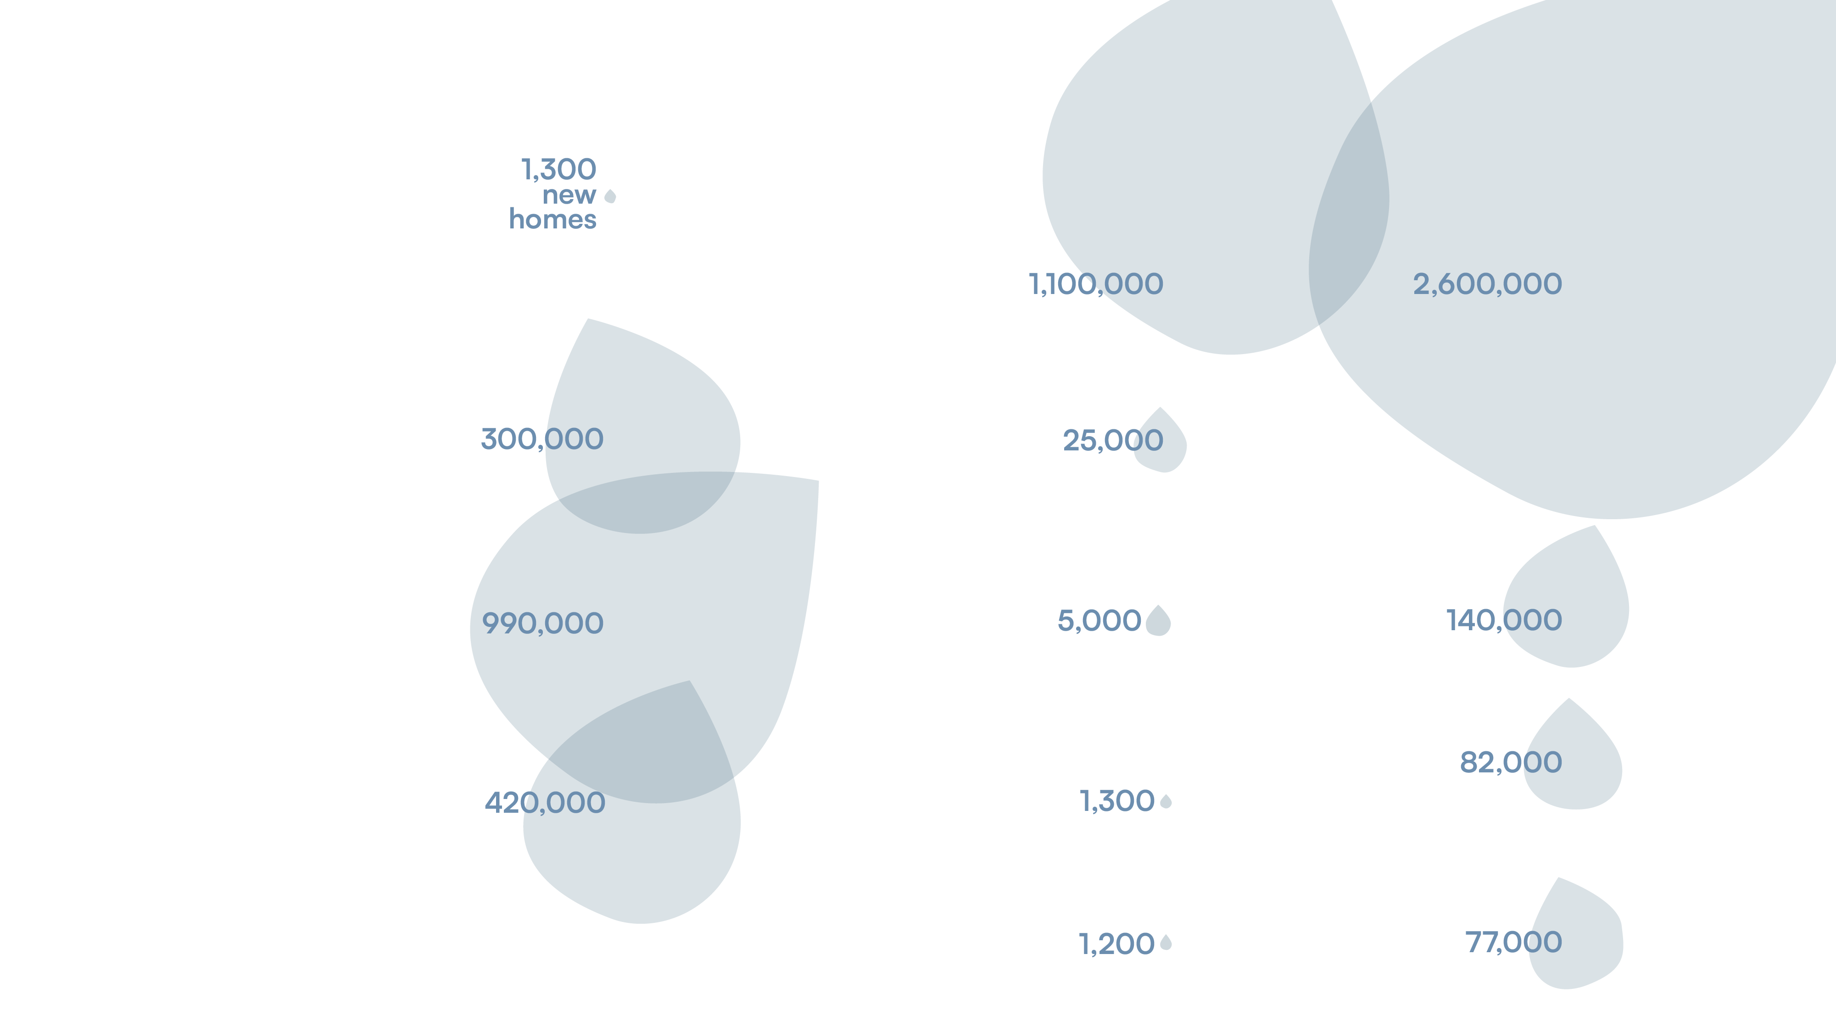
Flood risk to new homes will vary across the country

Slide 9
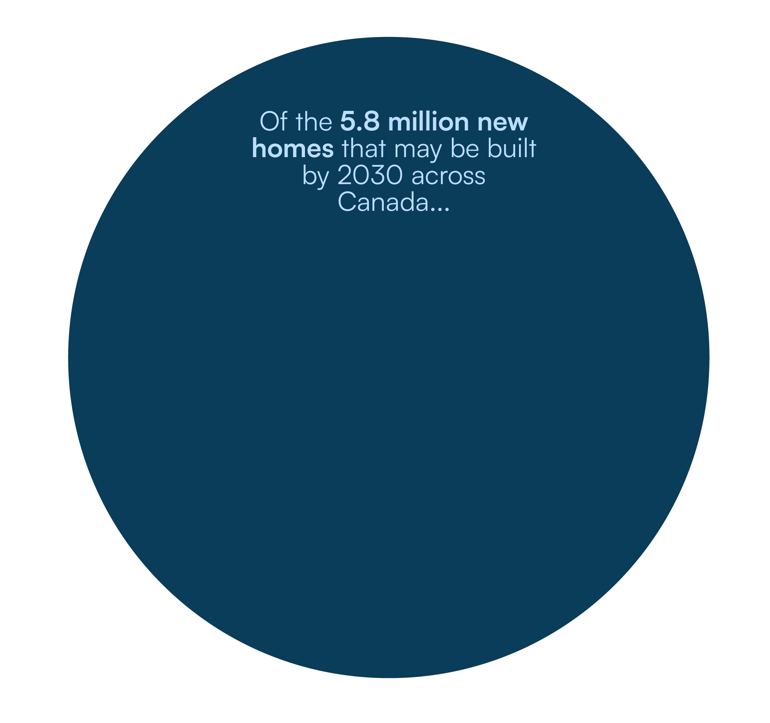
Building a small proportion of new homes on safer ground would reduce new flood damages by almost 80%

Slide 10
New housing could more than double wildfire losses in Canada
In B.C., wildfire damages could almost triple

Slide 11
92% of new wildfire losses could occur in just 20 municipalities

Slide 12
Challenges
and opportunities

Slide 13
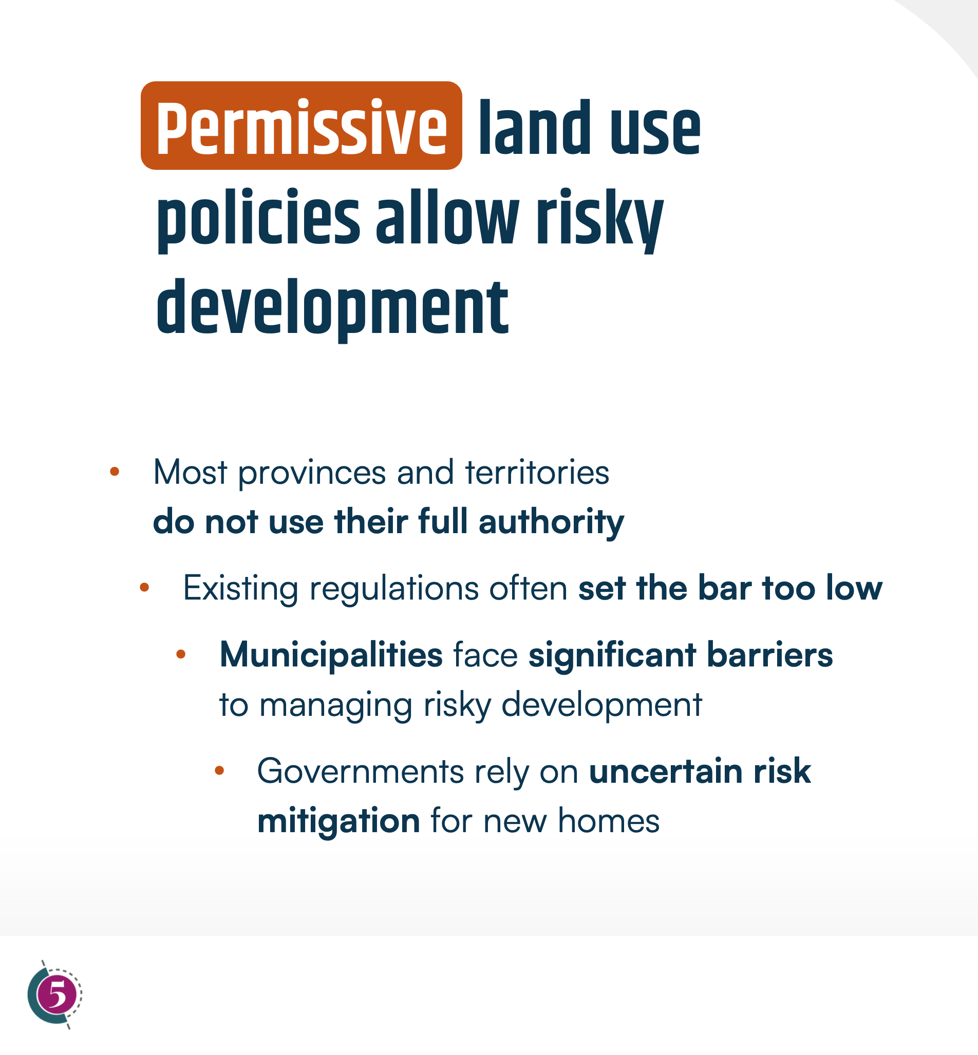
Permissive land use policies allow risky development
Strong and consistent land use regulations can direct development away from high-hazard areas
Most provinces and territories
do not use their full authority
Existing regulations often set the bar too low
Municipalities face significant barriers to managing risky development
Governments rely on uncertain risk mitigation for new homes

Slide 14
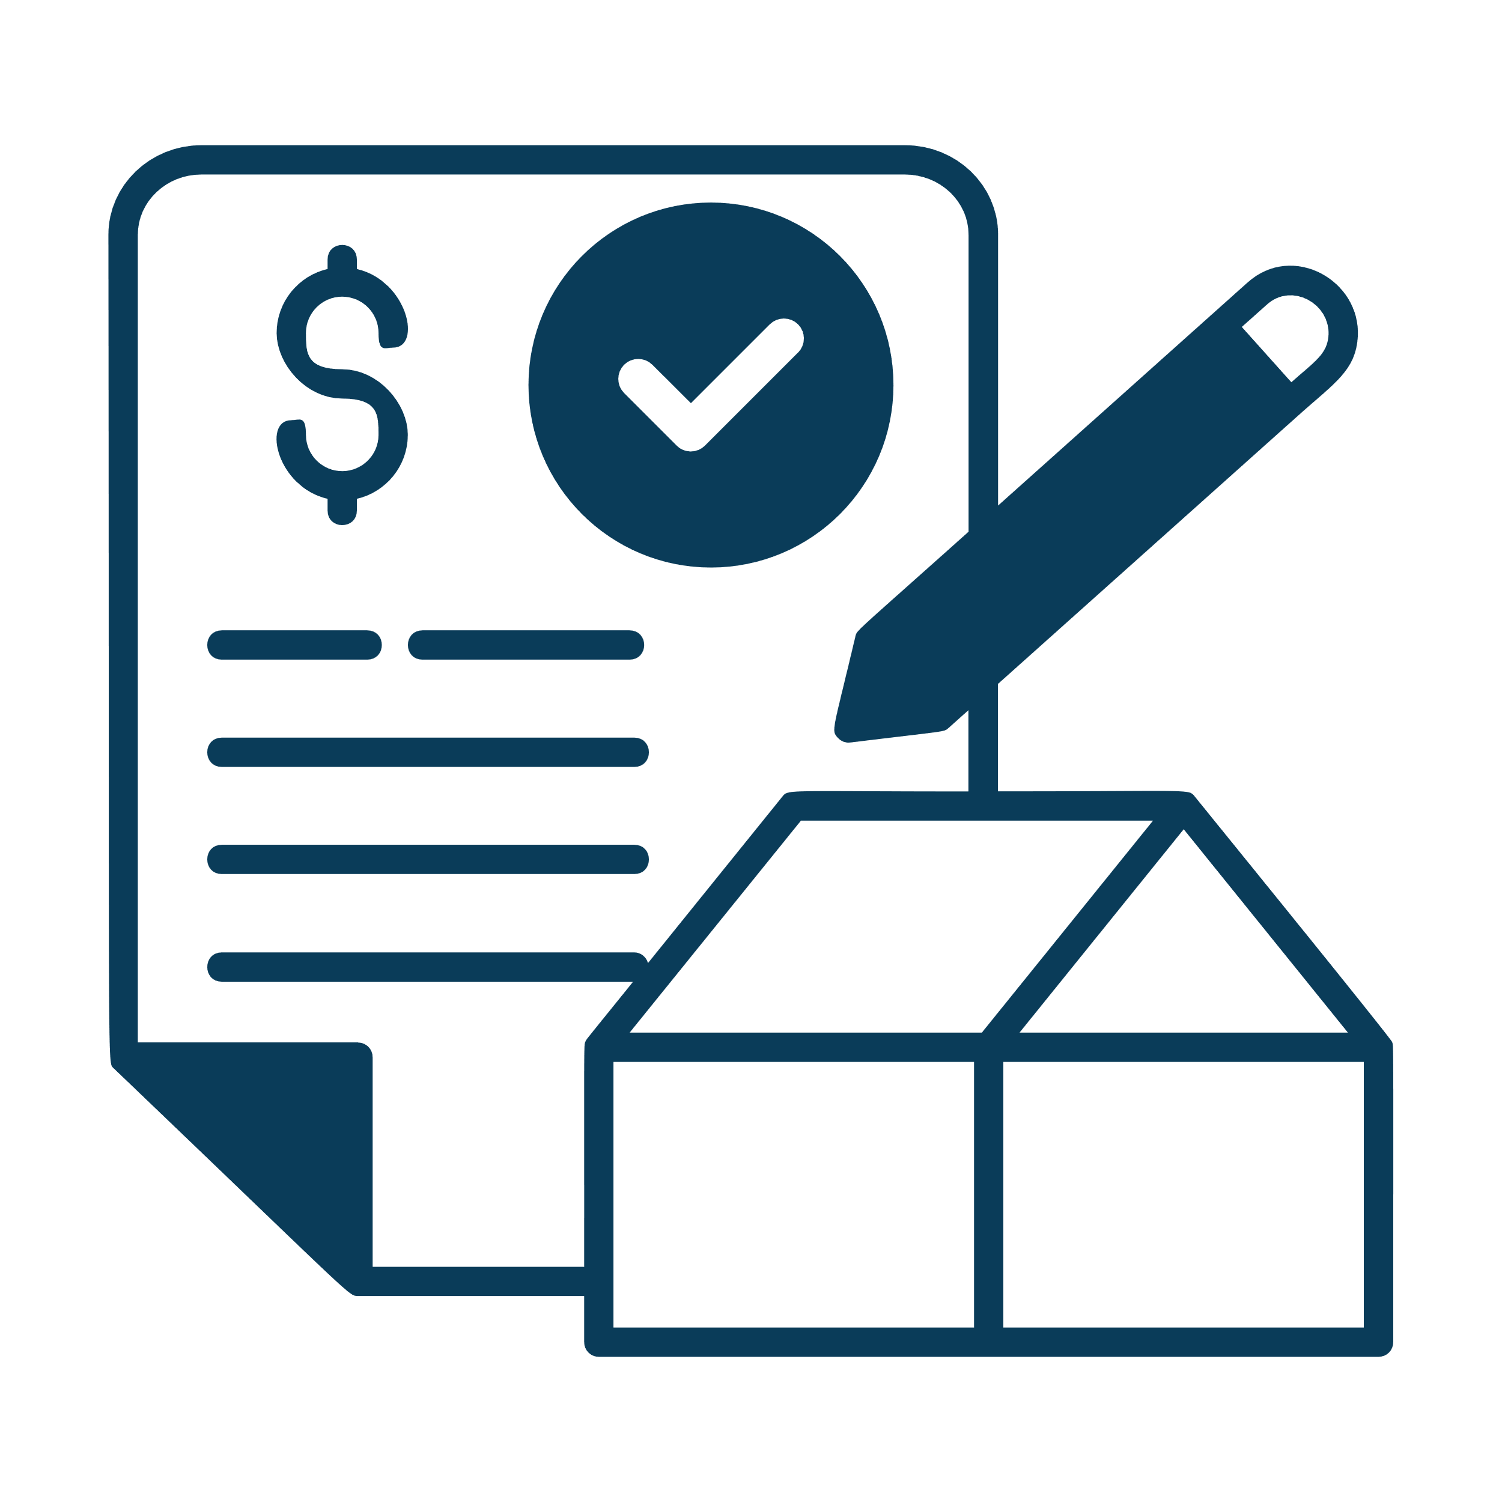
Misaligned housing and infrastructure policies can drive unsafe construction
Global best practices integrate climate hazards into housing and infrastructure funding
Housing targets and incentives may push development into high-risk areas, undermining affordability
Infrastructure funding often ignores climate risks to the housing it enables

Slide 15

Disaster programs create moral hazard
Well-designed disaster assistance and public insurance rules reduce moral hazard
Disaster assistance programs enable development in high-hazard areas
National public flood insurance could encourage dangerous housing choices

Slide 16

Inadequate hazard mapping prevents safer decision making
Making hazard information accessible and transparent empowers better housing decisions
Municipalities and the public lack key hazard information
Inaccessible maps and no disclosure leave homebuyers uninformed

Slide 17



Indigenous communities face unique barriers and challenges
Programs that empower local actions and decision making are having some success
On-reserve communities face acute housing needs and significant climate impacts
There is a unique governance context and major funding and capacity issues

Slide 18
Conclusions and Recommendations

Slide 19


CONCLUSIONS
1
Damages to new housing from flooding and wildfire are on track to cost households and taxpayers billions
4
Other policy gaps also drive unsafe housing development when land use policies are permissive
2
Permissive land use policies are a primary driver of risky housing construction
5
A lack of information about climate risk hampers smarter housing decisions
3
Steering development away from high-hazard areas can dramatically reduce losses without limiting housing growth

Slide 20
Ryan Ness
Sarah Miller

