Slide 1

PLAN CANADA FALL WEBINAR 2025
NOVEMBER 27
Can Travel Shape
Our Vision of Canada’s Future Cities?
Emilie K Adin, RPP, FCIP
“6.5/10 on a cheesiness scale” - my son

Slide 2
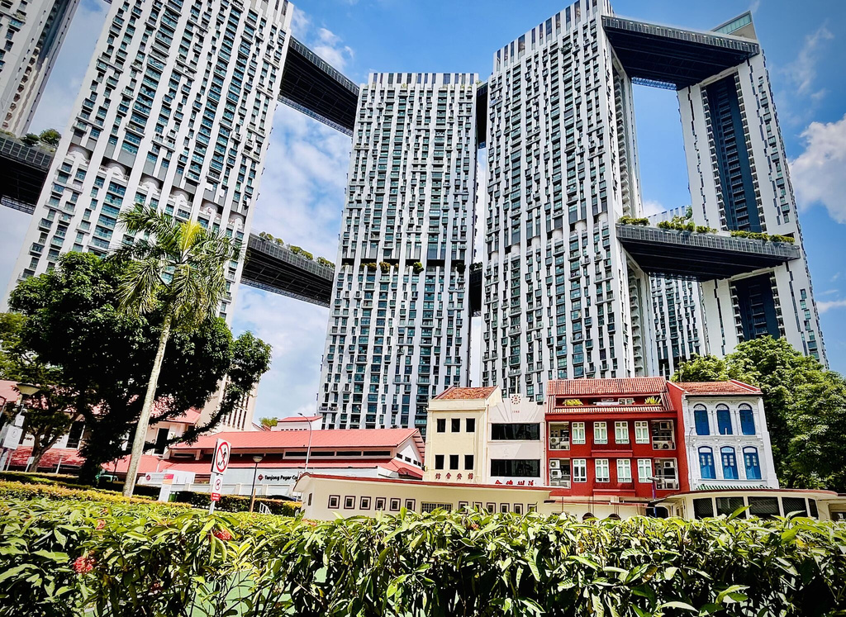
Travel is not an escape from our work as planners – it’s a way to deepen it.
3

Slide 3
“I do think that travelling and visiting other cities is the best education that any planner can have. It doesn't have to be Tokyo or Paris. It can be any city, of any scale.
You always kind of come away learning a little something. It's the best education any planner can get.”
-Jason Thorne, MCIP, RPP
Chief Planner for the City of Toronto
2

Slide 4
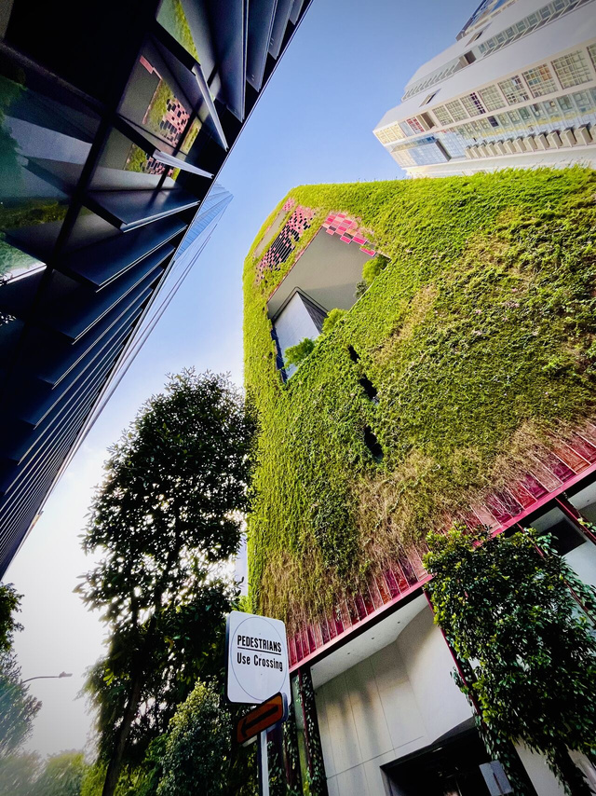
Letting Go…
of our ‘Backyard Blinders’
4

Slide 5
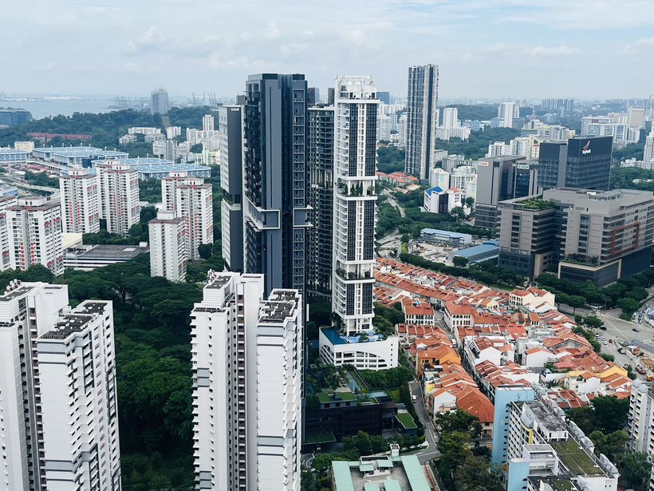
A city
that chose
a different path
5

Slide 6
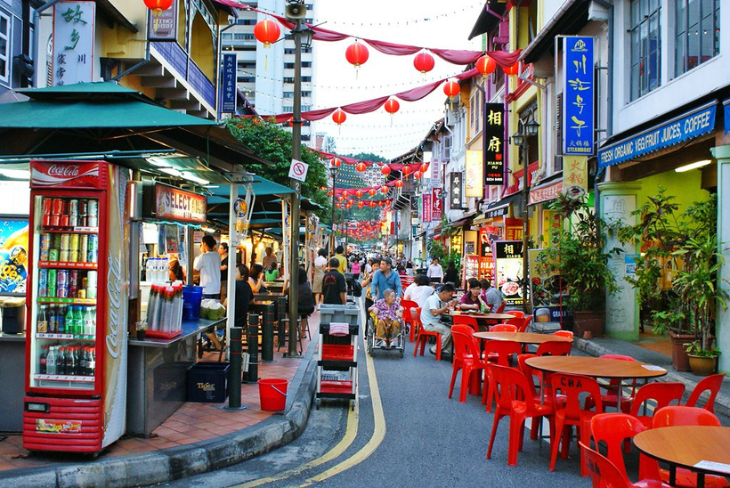
A walking tour through time
6

Slide 7
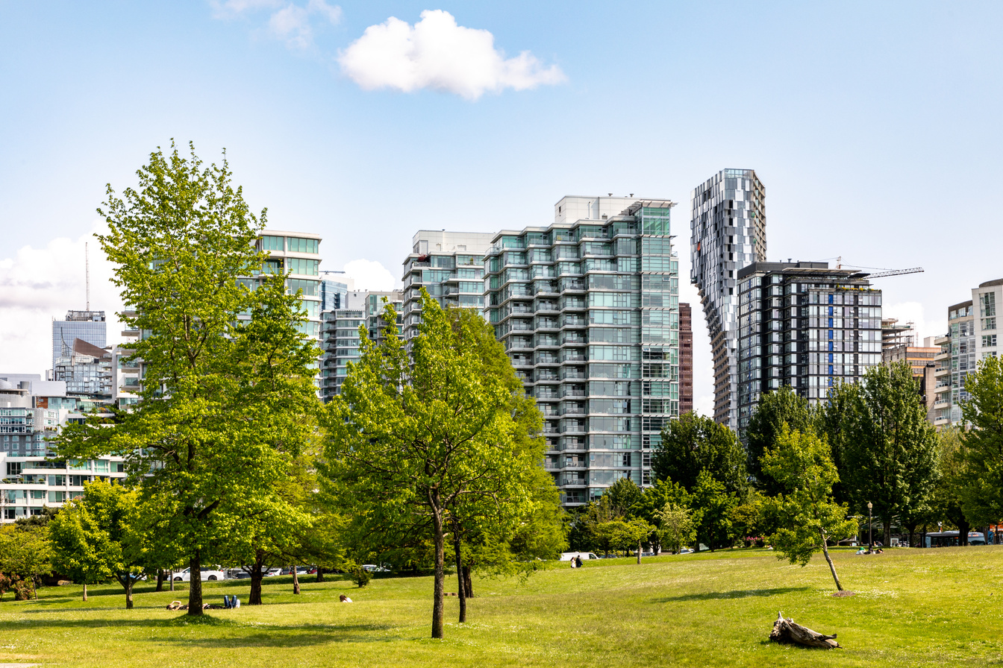
Live well,
live green,
live connected
7

Slide 8
Travel is the lens that sharpens our capacity to envision and shape
Canada’s urban future.
Thank you for listening!

